Slide 1




ISWC2014 Tutorial on Large Scale Reasoning Over Semantic Data
Presenters:
Jeff Z. Pan (University of Aberdeen)
Raghava Mutharaju (Wright State University)
Ilias Tachmazidis (University of Huddersfield)
Guilin Qi (Southeast University)

Slide 2
Agenda
9:10am – 9:45am
Motivations and Overview of Background Knowledge (Jeff, Ilias)
9:45am – 10:30am
Scalable OWL 2 DL reasoning based on approximation and divide-and-conquer approaches (Jeff)
10:30am – 11:00am
Coffee break
11:00am – 11:45am
Distributed Reasoning in OWL 2 EL (Raghava)
11:45am – 12:30pm
Large Scale Non-Monotonic Reasoning (Ilias)

Slide 3
Agenda
2:00pm – 2:45pm
Scalable RDFS Reasoning Using MapReduce (Raghava)
2:45pm – 3:30pm
Applications (Raghava, Jeff)
3:30pm – 4:00pm
Coffee break
4:00pm – 4:45pm
Lesson Learned and Conclusions (Jeff)

Slide 4

Session Agenda
Applying reasoning in domain applications
Various domains
Smart City Application
Applying reasoning beyond domain applications
Software engineering
Content management systems

Slide 5
Applications
OWL and RDF reasoning is used in several domains.
Automobiles: Volkswagen
Website content is annotated with RDFa
RDF is extracted from RDFa
Reasoning is performed over the extracted RDF data

Slide 6
Applications
Energy management
Aim is to give personalized energy saving tips to the customers.
An OWL reasoner is used to check whether a tip is appropriate for a given customer.
SPARQL is used to retrieve the class names which contain the tips.

Slide 7
Applications
Embedded Systems
Ambient Assisted Living (AAL) is a set of technologies embedded in living space.
They provide real-time assistive services in a context-aware manner.
Reasoning is used to provide context awareness.

Slide 8
Applications
Traffic data reasoning
This is the work going on at Smarter Cities Technology Center, IBM Research, Dublin.
Traffic congestion leads to wastage of time, fuel and money.
Reasoning, along with other AI techniques are used

Slide 9
Applications
to diagnose and predict traffic congestions.
This analysis is useful for city managers.
Sensors are placed all over the city to collect traffic data.
Static and dynamic sensors tracking location of

Slide 10
Applications
the buses, speed etc.
Data is updated every few seconds.
This application is called STAR-CITY and a video of it is available at http://goo.gl/TuwNyL

Slide 11
Applications
Three different reasoning techniques are used.
Deductive reasoning on dynamic knowledge for keeping knowledge up-to-date.
Inductive reasoning for learning and prediction.
Abductive reasoning for diagnosis.
Distributed OWL 2 EL classification comes under deductive reasoning.

Slide 12
Applications
Background knowledge is captured using an OWL 2 EL ontology.
Expressivity provided by OWL 2 EL is sufficient
Finding subsumption relation is in PTIME.
Ontologies for other domains such as Time, Space, Weather and events are also used.

Slide 13
Applications
Some information is captured using SWRL rules.
Data stream is converted into EL++ axioms.
New individuals from the ontology stream are classified.

Slide 14
Applications
This makes the knowledge base complete w.r.t subsumption relationship.
Causal relationships and correlation with other streams such as city events are identified.
Apart from Dublin, this application is tested in Miami, Bologna and Rio.

Slide 15
References
http://www.w3.org/2001/sw/sweo/public/UseCases/Volkswagen/
Pierre Chaussecourte, Birte Glimm, Ian Horrocks, Boris Motik, Laurent Pierre: The Energy Management Adviser at EDF. ISWC 2013.
Thibaut Tiberghien, Mounir Mokhtari, Hamdi Aloulou, and Jit Biswas. 2012. Semantic reasoning in context-aware assistive environments to support ageing with dementia. ISWC 2012.

Slide 16
Session Agenda
Applying reasoning in domain applications
Overview
Smart City Application
Applying reasoning beyond domain applications
Software engineering
Content management systems

Slide 17
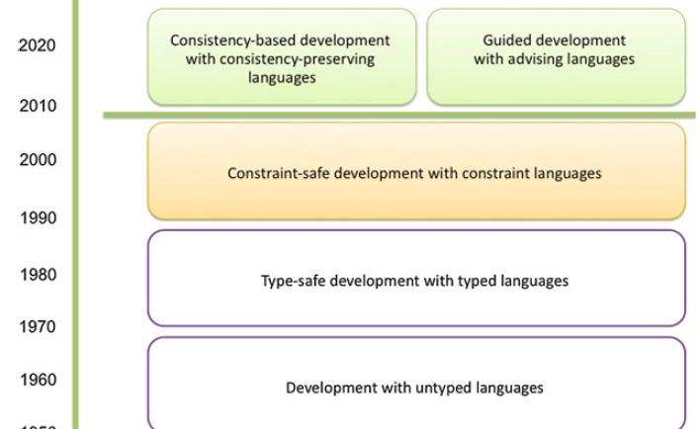
Importance of Software and Their Quality
Software plays a central role in modern technologies
E.g. home healthcare service software market is estimated to reach $6.4billion by 2018
Software quality is a key aspect
Vision: From type safe to consistency based and guided development
Jeff Z. Pan
17

Slide 18
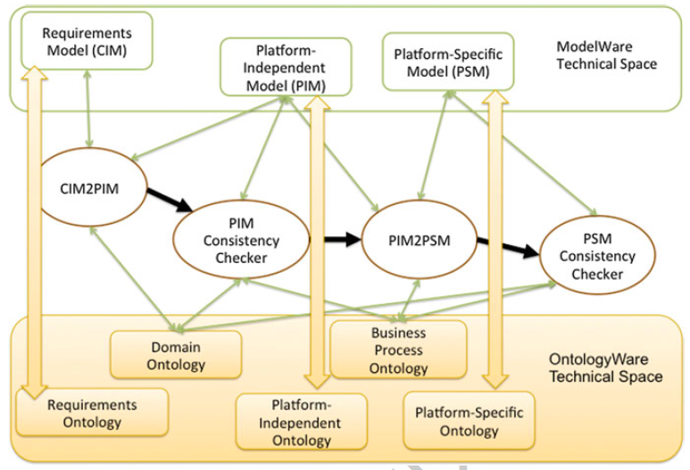

Some Benefits of ODSD
B1: Checking consistency and completeness
B2: Evolvable schema available during deployment
B3: Going beyond static semantics

Slide 19
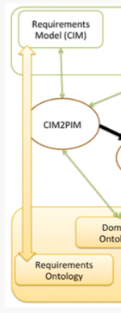
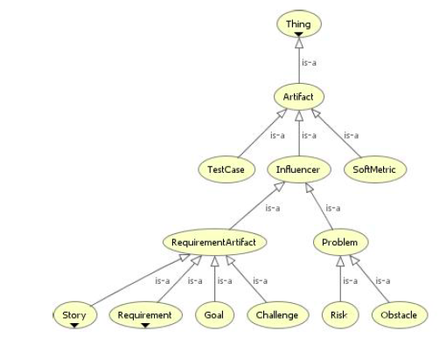
Case Study 1: Requirement Engineering
Quality rules for requirements
The requirement configuration must be consistent
Requirements must be complete
Each requirement must state its mandate (optional or mandatory)
Requirements with a positive contribution to a challenge or goal should be included in the requirement configuration
There must be no optional requirement with a high risk or high cost
There must be no requirement that is a negative contribution to a goal to be achieved
…
Some core concepts in a Requirement Ontology

Slide 20
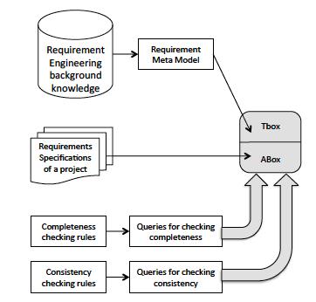
Case Study 1: Requirement Engineering

Slide 21
Example: Consistency Checking
Chosen requirements can not exclude each other
Example requirement relations
isExclusionOf( Functional Requirement5; Functional Requirement7)
ChosenRequirement( Functional Requirement5)
ChosenRequirement( Functional Requirement6)
DemandRequirement ( Functional Requirement6; Functional Requirement7)

Slide 22
Example: Completeness Checking
Requirements knowledge in the Requirements Ontology:
FR1, FR2, FR3, Goal1, Goal2, Author1
FR1 isAlternativeTo FR2
FR1 isNegativeContributionTo Goal2
FR2 isAuthoredBy Author1
FR3 hasSameAuthorAs FR2
Example quality rule: all requirements should have author information
warning: FR1 has no author
Require the use of NBox in the requirement ontology
e.g. one should close isAuthoredBy by adding isAuthoredBy into NBox
Jeff Z. Pan
22

Slide 23
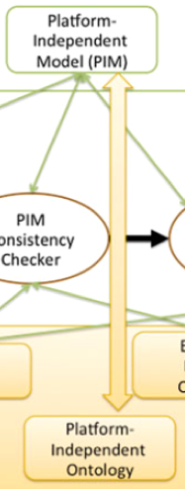
Case Study 2: Linked Data CMS
Vision: Linked Data CMS
encourage more user generated SW data directly from ordinary CMS users
while reusing existing successful CMS platforms
Mapping between CMS entities (platform independent) and ontology entities
template ⬄ (browsing) class
field ⬄ datatype properties
relation ⬄ object properties

Slide 24
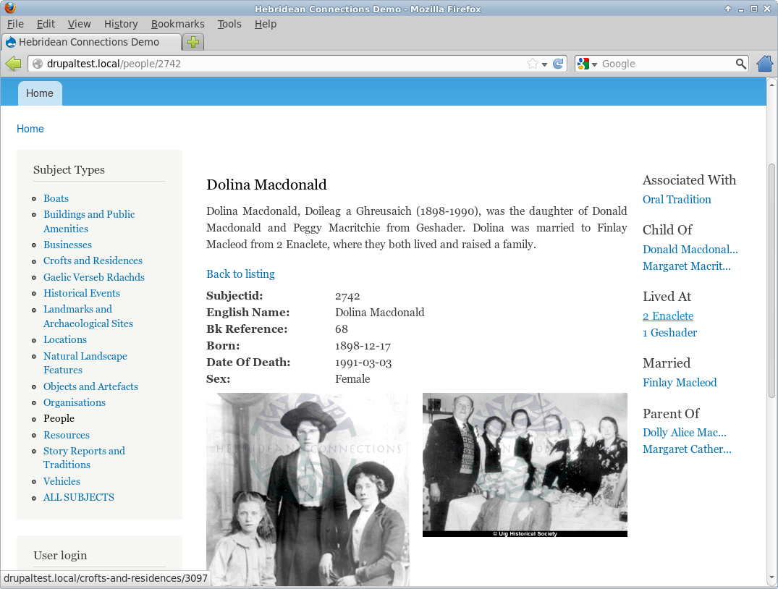
Browsing Classes
A browsing class represents an OWL class selected to provide views of their instances in CMS
With more details, a browsing class b contains
bC: an OWL class as the base class
bDP: a set of datatype properties
bOP: a set of object properties
bω: a function mapping each p in bOP to an OWL class tc such that
the range of p is a subclass of tc, and
tc is the base class of some browsing class

Slide 25
Validation of LD-CMS Configurations
Formally, a LD-CMS configuration can be represented as an OWL 2 meta-ontology
Validate the domains and ranges of all the object properties of each browsing class b in a LD-CMS configuration: for each p in bOP,
the base class bC should be a subclass of the domain of p
the range of p should be a subclass of the target class tc
the target class tc is the base class of some browsing class
The validation should be performed whenever the ontology or the configuration is updated

Slide 26

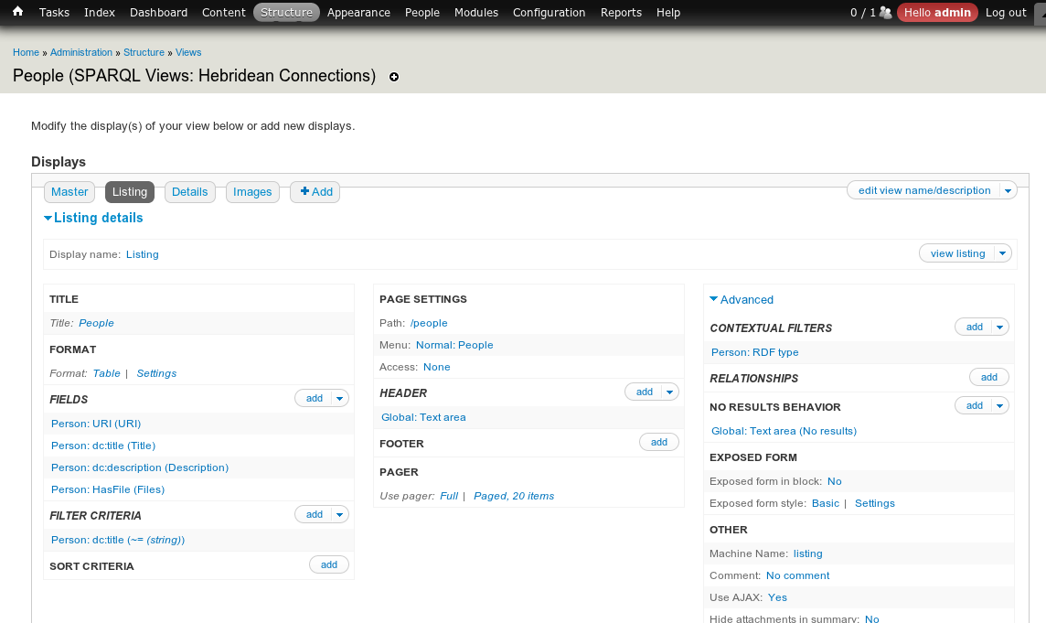
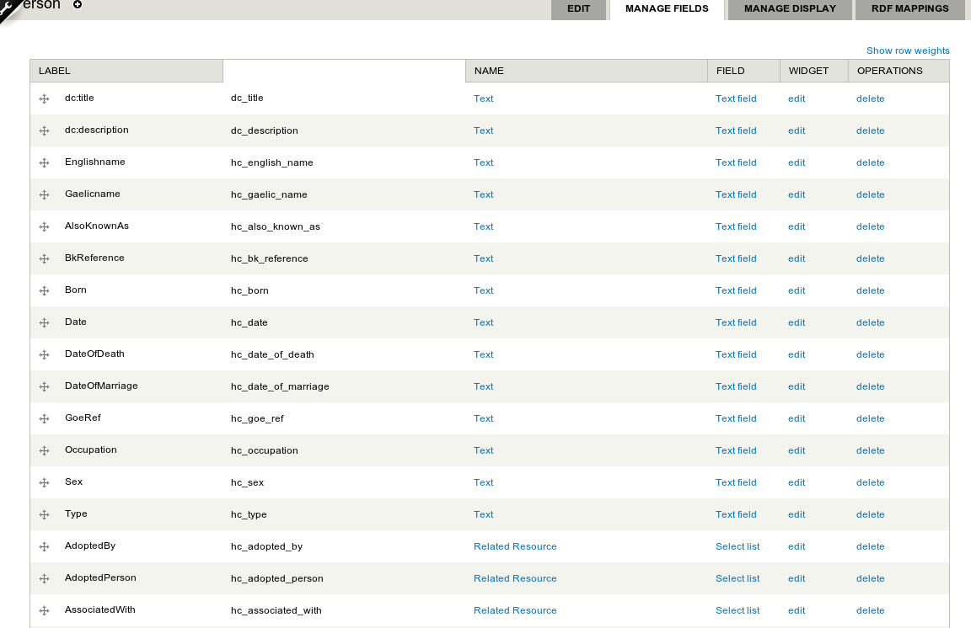
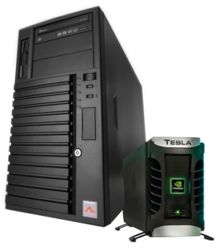
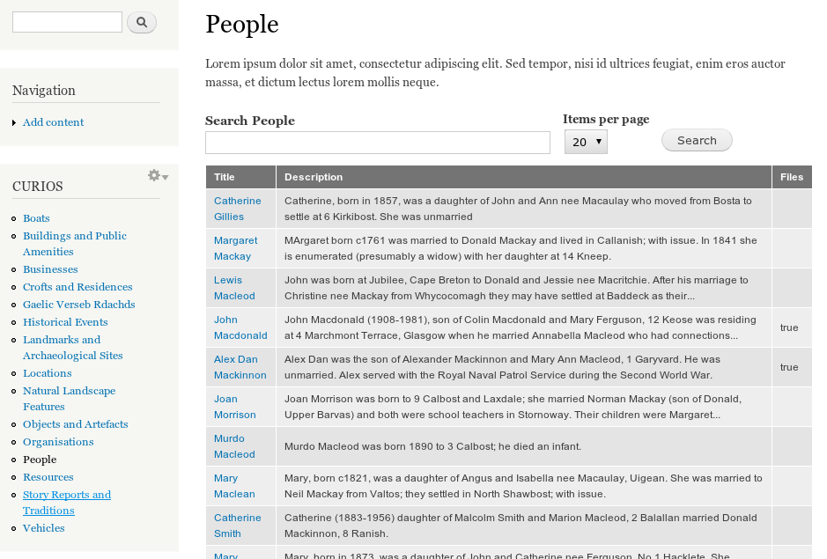

Configurations of LD-CMS
Domain ontology
LDCMS configuration (in php)
26
26

Slide 27
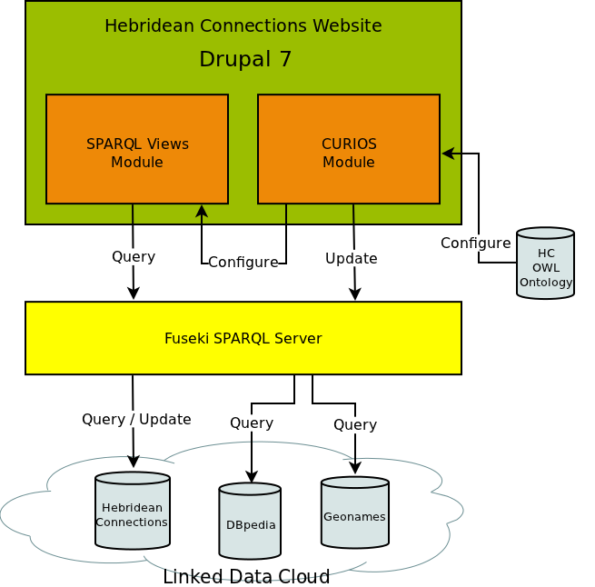
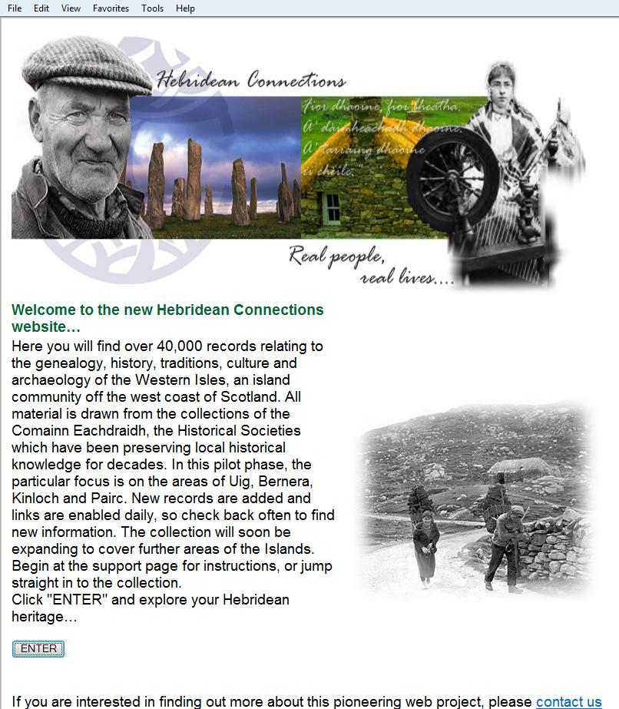
Implementation (Open Source)
LD-CMS as CURIOS module in Drupal 7
configurations specified in php
to create entities in Drupal
Support three types of views
list view
details view
update view
Centralises the maintenance of the structure of the CMS
Create an entire Drupal site using SPARQL Views
based on an ontology and a configuration

Slide 28
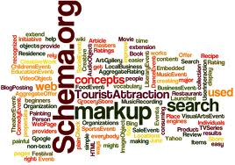
Letting the Crowd Contribute to Linked Data (LD)
Lots of linked data available now
though only small percentage of web data
Schema .org is seen on 15% of all websites crawled by Google
how about the other schemas?
LD based CMS could help generating linked data while people produce web pages

Slide 29
The more data available out there, the more likely we have more applications ...

Slide 30

Thank you!

